Slide 1
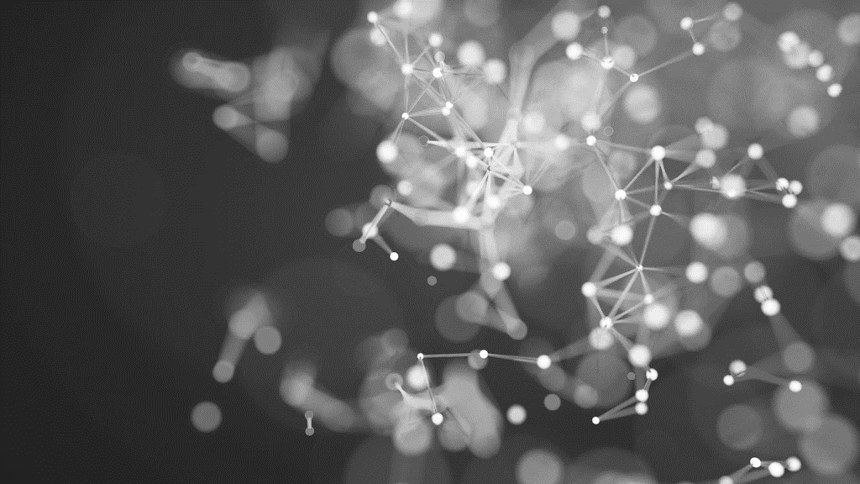
History of computer
Brief review
Generations

Slide 2
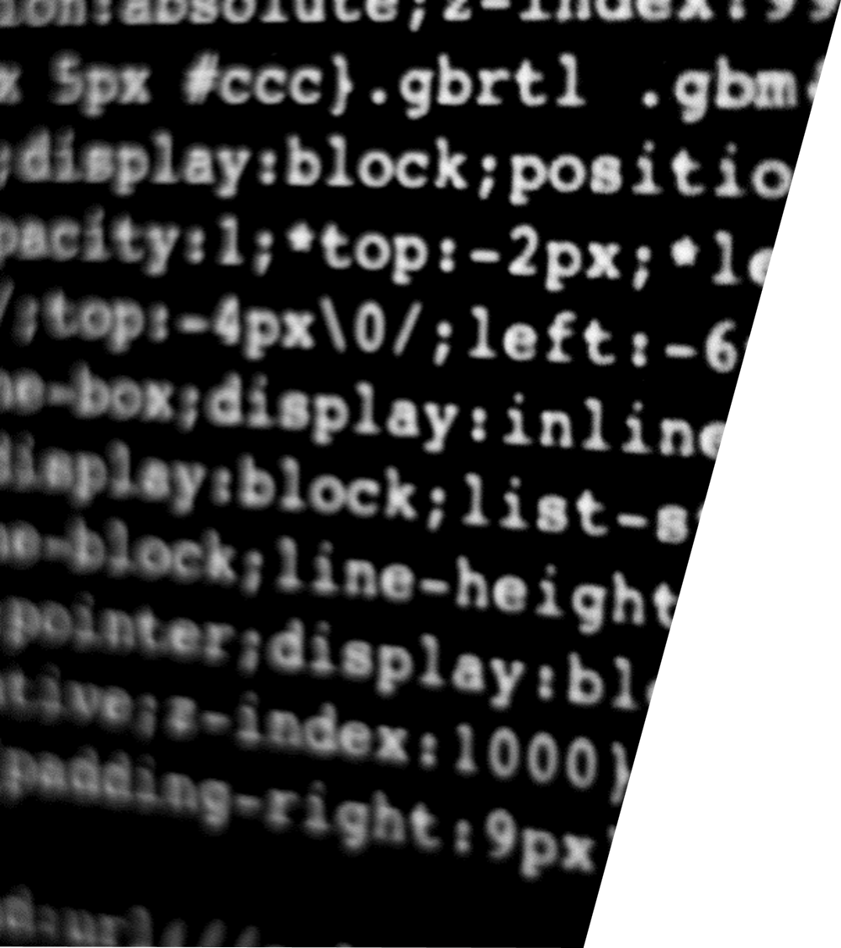
Why computer?
Computer has become very important nowadays because it is very much accurate, fast and can accomplish many tasks easily. Otherwise to complete those tasks manually much more time is required. It can do very big calculations in just a second. Moreover it can store huge amount of data in it.

Slide 3
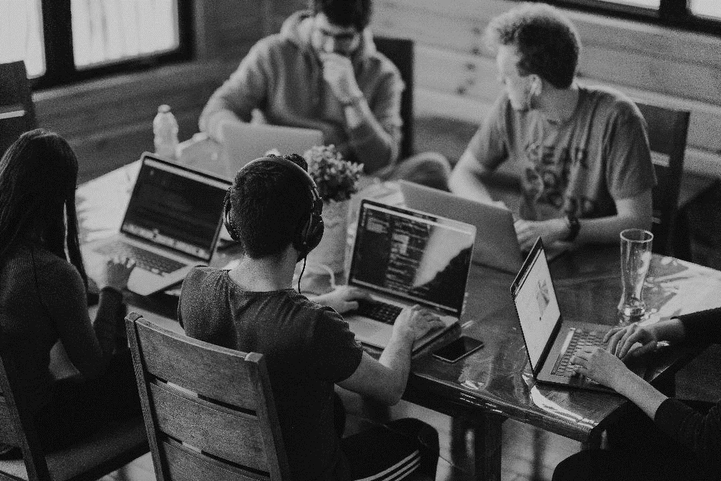
INTRODUCTION
History of Computer
The first counting device was used by the primitive people. They used sticks, stones and bones as counting tools. As human mind and technology improved with time more computing devices were developed.

Slide 4
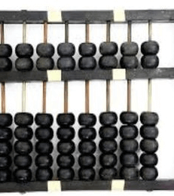
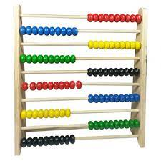
The history of computer begins with the birth of abacus which is believed to be the first computer. It is said that Chinese invented Abacus around 4,000 years ago.
Abacus

Slide 5
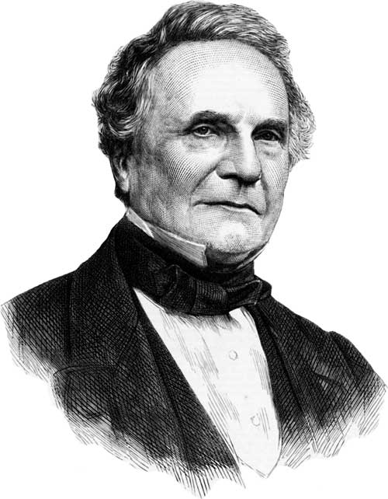
Charles Babbage, who was born in 1791, is regarded as the father of computing because of his research into machines that could calculate. Babbage's Difference Engine Number 1 was the first device ever devised that could calculate and print mathematical tables.
Charles Babbage

Slide 6
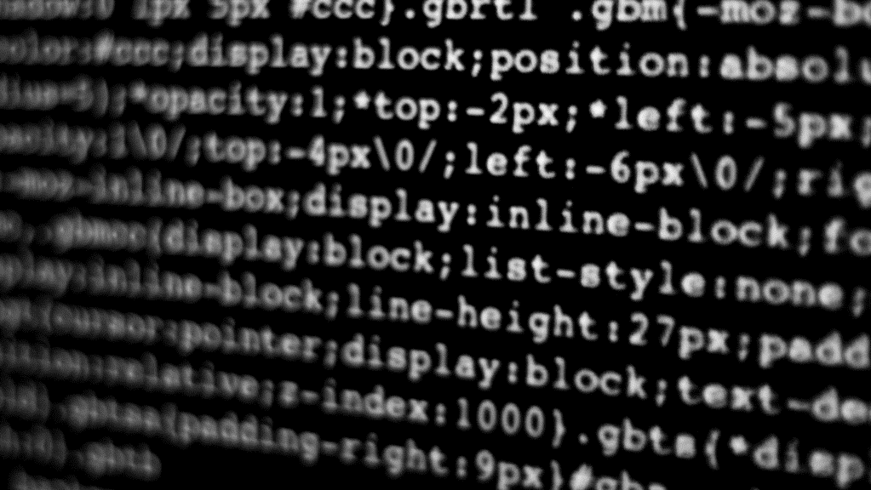
Generations of Computers
A generation of computers refers to the specific improvements in computer technology with time. In 1946, electronic pathways called circuits were developed to perform the counting. It replaced the gears and other mechanical parts used for counting in previous computing machines.

Slide 7
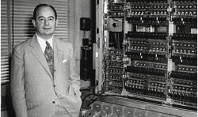
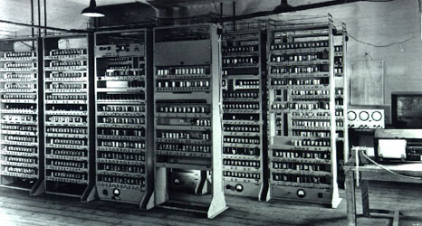
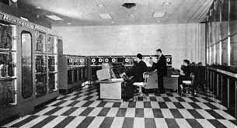
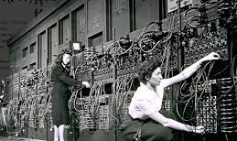
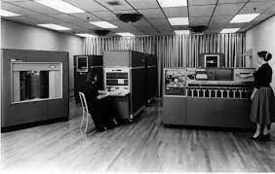
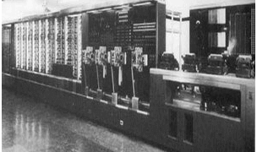
First Generation Computers
The first generation (1946-1959) computers were slow, huge and expensive. In these computers, vacuum tubes were used as the basic components of CPU and memory.
Some of the popular first generation computers are;
ENIAC ( Electronic Numerical Integrator and Computer)
EDVAC ( Electronic Discrete Variable Automatic Computer)
UNIVACI( Universal Automatic Computer)
IBM-701
IBM-650

Slide 8
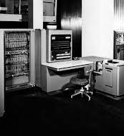
The second generation (1959-1965) was the era of the transistor computers. These computers used transistors which were cheap, compact and consuming less power; it made transistor computers faster than the first generation computers.
Second Generation Computers

Slide 9
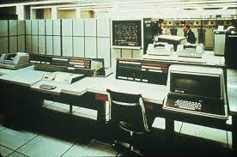
The third generation computers used integrated circuits (ICs) instead of transistors. A single IC can pack huge number of transistors which increased the power of a computer and reduced the cost. Some of the popular third generation computers are; IBM-360 series Honeywell-6000 series PDP(Personal Data Processor) IBM-370/168 TDC-316
Third Generation Computers

Slide 10
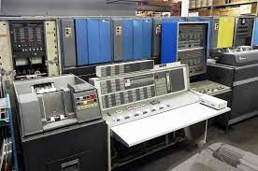
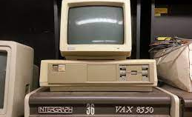
Fourth Generation Computers
The fourth generation (1971-1980) computers used very large scale integrated (VLSI) circuits; a chip containing millions of transistors and other circuit elements. These chips made this generation computers more compact, powerful, fast and affordable. The programming languages like C, C++, DBASE were also used in this generation.

Slide 11
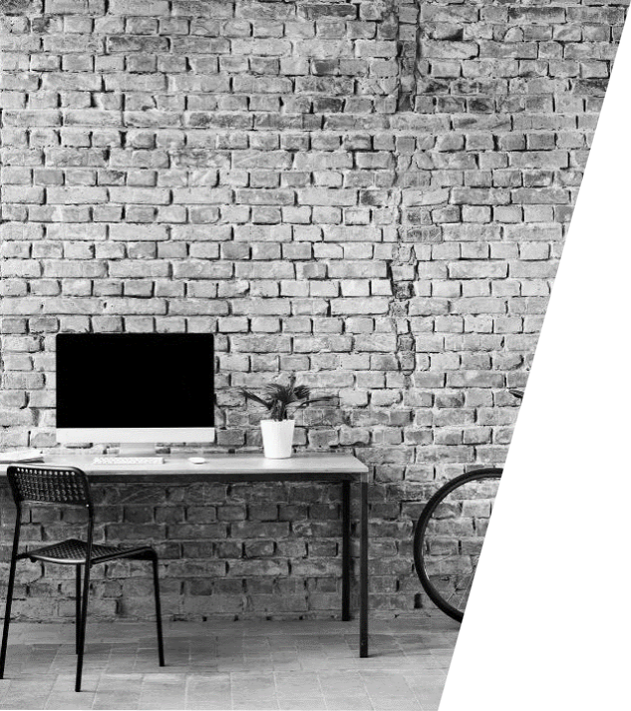
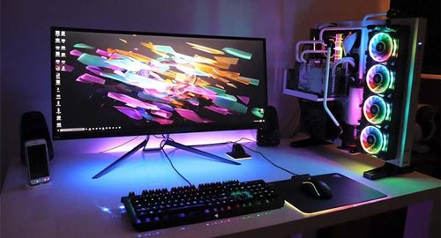
Fifth Generation Computers In fifth generation (1980-till date) computers, the VLSI technology was replaced with ULSI (Ultra Large Scale Integration). It made possible the production of microprocessor chips with ten million electronic components. This generation computers used parallel processing hardware and AI (Artificial Intelligence) software. The programming languages used in this generation were C, C++, Java, .NET, etc.

Slide 12
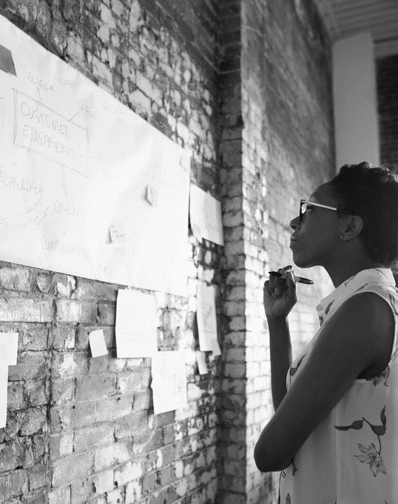
What is the future of computer?
Future computers promise to be even faster than today's computers and smaller than a deck of cards. Perhaps they will become the size of coins and offer "smart" or artificial intelligence features like expert intelligence, neural network pattern recognition features, or natural language capabilities

Slide 13



THANK YOU
Wali Muhammad Ahmad
+92 314 7363206
Wali.Muhammad.ahmad.com
Introduction to Computer

